Slide 1
GAR
Session 06: The Legend of Zelda

Slide 2
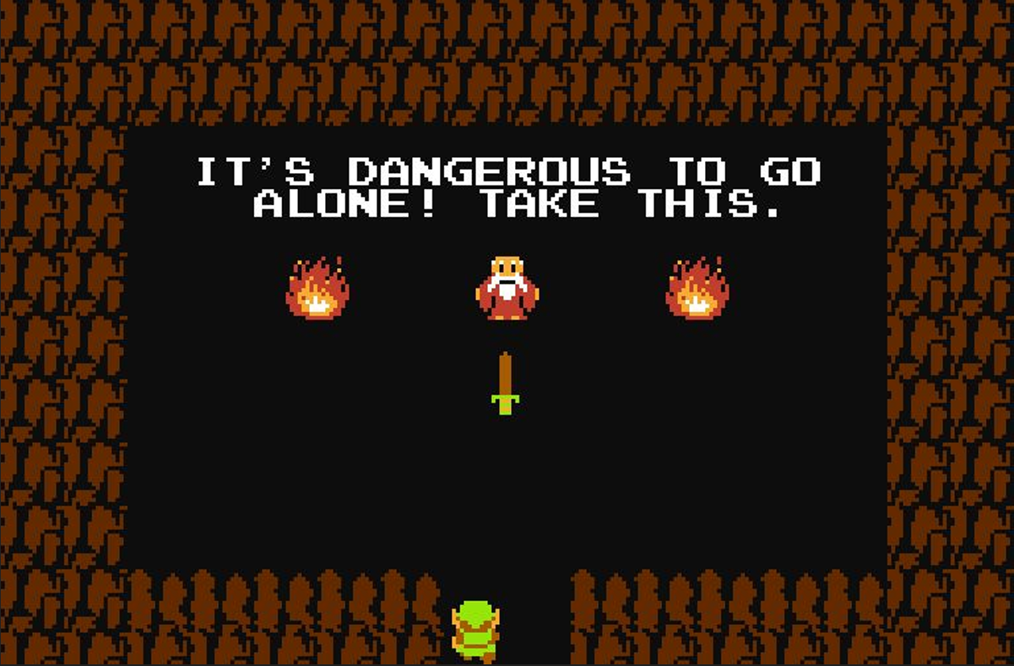
The Legend of Zelda

Slide 3
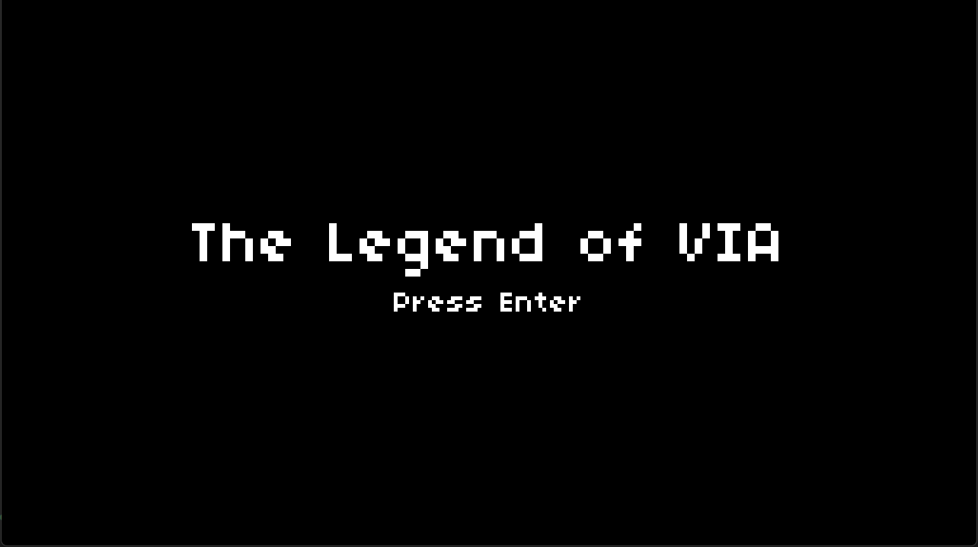
Today’s Goal

Slide 4
Today’s Topics
Assets and Tooling
Dungeon Generation
Hitboxes/Hurtboxes
Observer Pattern (Delegates & Events)
Screen Scrolling
Data Driven Design

Slide 5
Source Code
All Source code for today’s game can be found here:
  https://github.com/Metamate/gmd2-zelda
Walkthrough in README.md
The game is built up in steps: Zelda0 → Zelda7
  Each step is a separate project that adds one concept
  Compare neighbouring steps to see exactly what changed
Zelda7 is the finished game: explore it, and start the exercises from it

Slide 6
Steps
Zelda0: rooms generated as tilemaps
Zelda1: the player, top-down movement
Zelda2: enemies and AI
Zelda3: combat (hitboxes, hurtboxes and damage)
Zelda4: events (player death, the floor switch and doorways)
Zelda5: screen scrolling between rooms
Zelda6: stenciling the door arches
Zelda7: audio (the finished game)

Slide 7
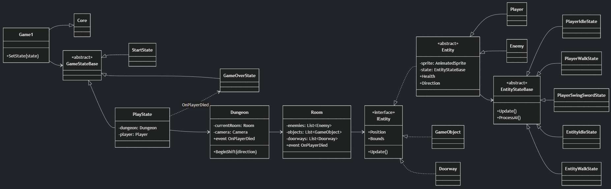
Diagram

Slide 8
Explore the Codebase
Take ~15 minutes to browse the finished game, Zelda7. Use the README as a guide if you need it.
Find where the game transitions between the title screen, gameplay, and game over
How does the player move?
Find where a new room is generated and what it contains when it is created
The player and enemies share a lot of code
  Find the common base and explain what it provides
Trace what happens from the moment the player presses the spacebar to an enemy taking damage

Slide 9

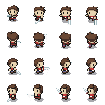
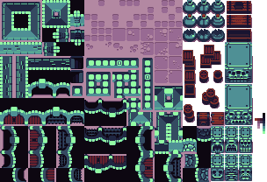
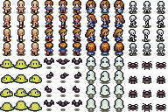
Assets
Notes:
Today’s assets don’t all conform to the same grid size

Slide 10
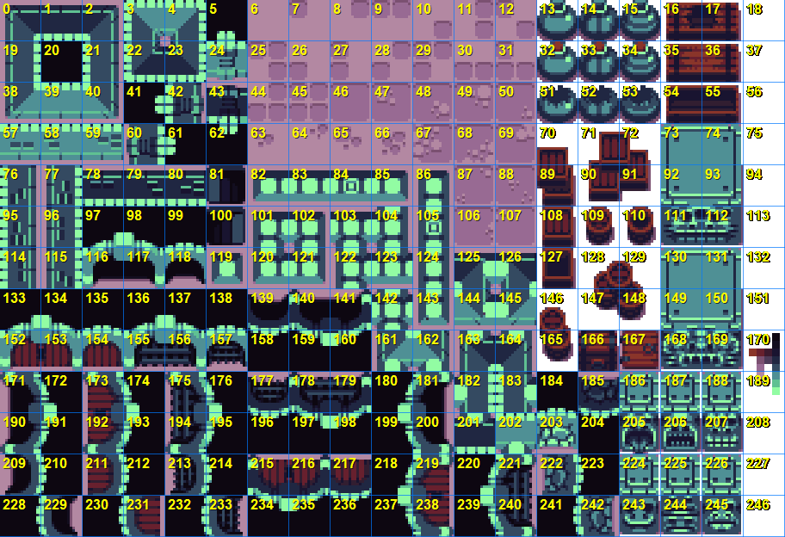
Tooling

Slide 11
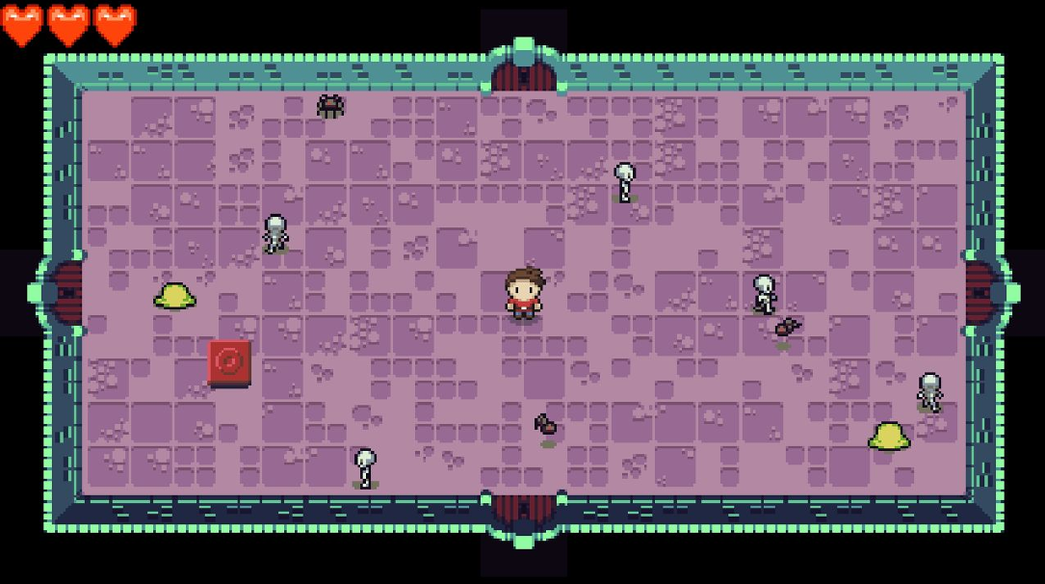
Top-Down Perspective
Notes:
Player art shifted perspective
Notice collider correction to “fake perspective”

Slide 12
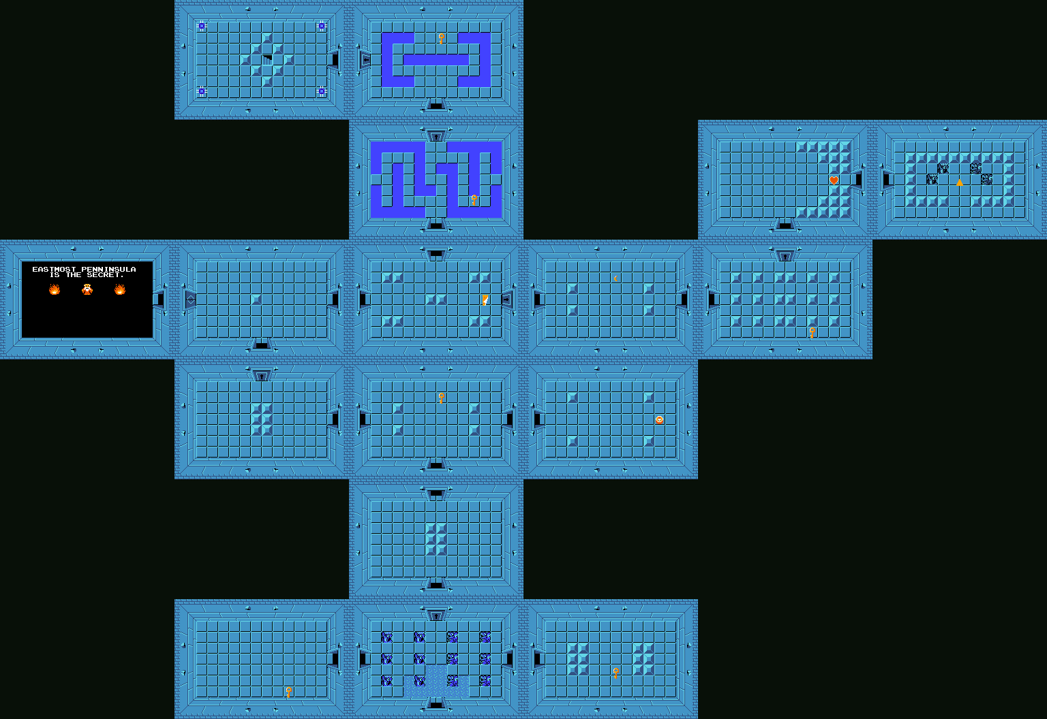
Dungeon Generation
Dungeon Maps
Notes:
Infinite dungeon generation

Slide 13
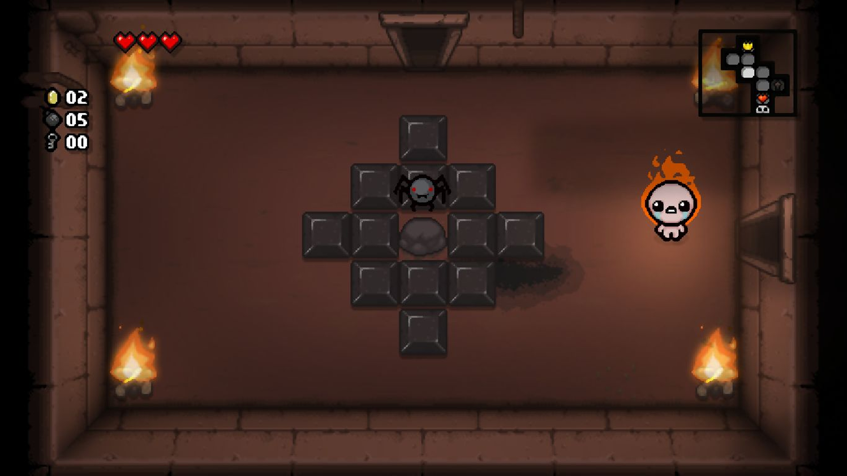
Dungeon Generation

Slide 14
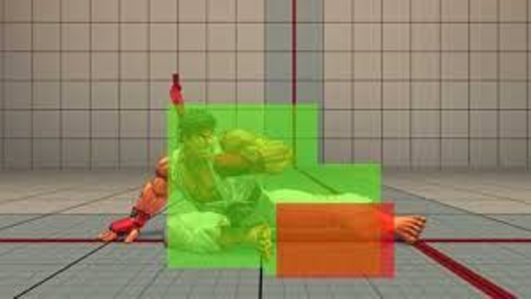
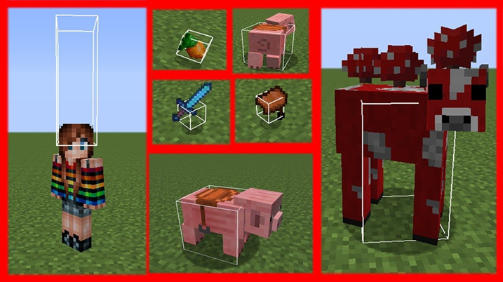
Hitboxes/Hurtboxes
Hitbox
Hurtbox
Notes:
Show example of Debug.Draw

Slide 15
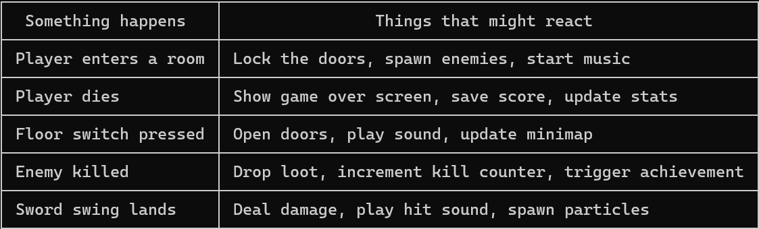
Events in Games
Games are full of moments where something happens and other things need to react
The thing that happened shouldn't need to know what those other things are
Events let you flip that around: the trigger just announces, anything that cares subscribes
Notes:
The domain maps cleanly to the concept. Games are naturally event-driven — something happens (player takes damage, enemy dies, room clears) and multiple systems need to react.
Notice that the trigger (sword hits enemy) and the reactions (damage, sound, particles) are completely unrelated concerns - events keep them from getting tangled together - This also makes the reactions easy to add or remove later without touching the trigger code.
Keep in mind, not all of these need to be event-based

Slide 16
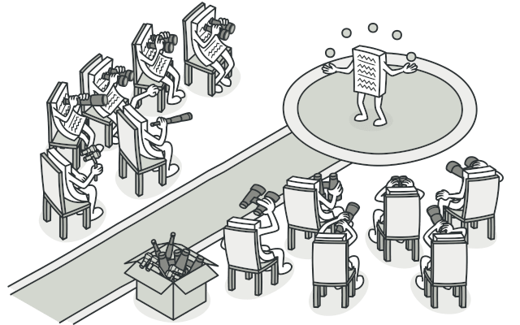
Observer Pattern
Notes:
decoupling

Slide 17
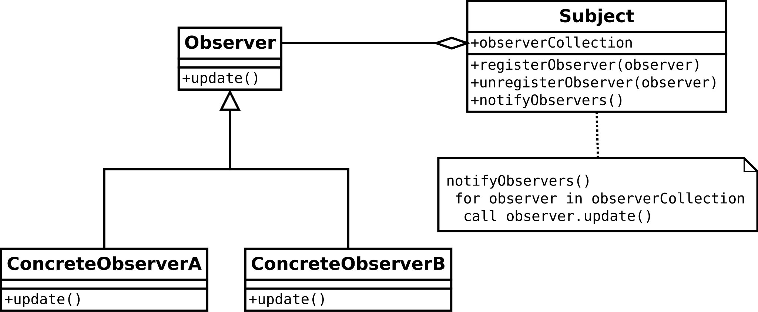
Observer Pattern
Notes:
decoupling

Slide 18
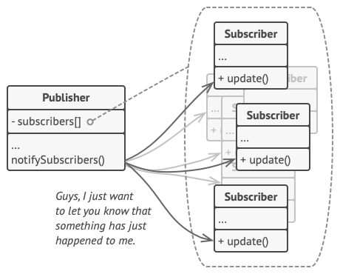
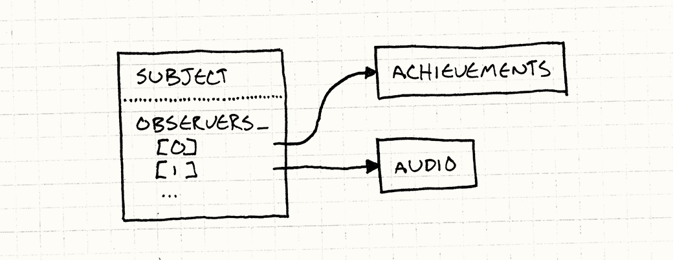
Publisher-Subscriber / Subject-Observer

Slide 19
However…
In C#, we don’t need to implement the observer pattern. Events are part of the language!

Slide 20
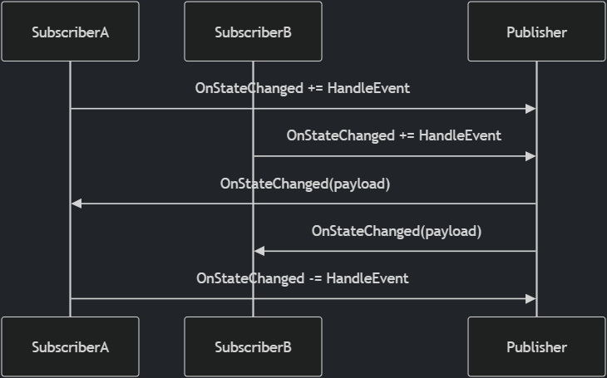
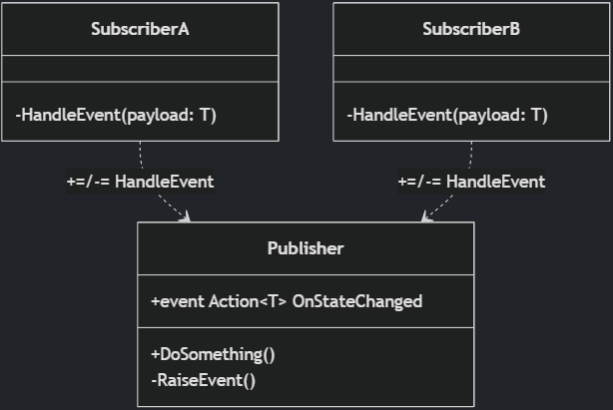
C# Events

Slide 21
Delegates
A delegate is a variable that holds a reference to a method — call it later, from anywhere.
// Built-in delegate types:
Action // returns void, no args
Action<T> // returns void, takes T
Func<T> // returns T, no args
// GameObject.cs
public Action OnCollide { get; set; }
// Room.cs
switchObj.OnCollide += () => {
switchObj.State = "pressed";
foreach (var d in Doorways) d.IsOpen = true;
};
// Assign one handler
obj.OnCollide = () => Console.WriteLine("hit");
// Add multiple handlers
obj.OnCollide += () => PlaySound("hit");
obj.OnCollide += () => FlashRed();
// Call all subscribers
OnCollide?.Invoke();
Notes:
C# way of doing callbacks
A callback in C# refers to a function or method that is passed as an argument to another method, allowing the receiving method to invoke it at a later time
This is commonly used in scenarios where you want to execute a specific action after a task is completed, such as in asynchronous programming or event-driven systems.
Func<Room> in Dungeon (factory)

Slide 22
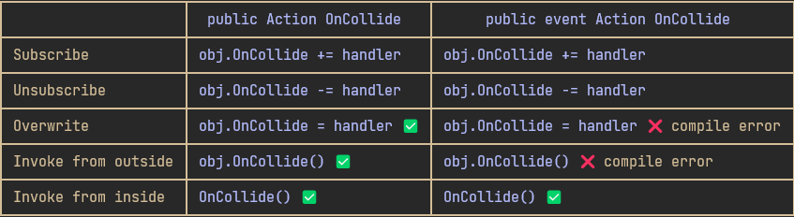
C# Events
An event is a delegate with guardrails
  under the hood it is a delegate, but the event keyword restricts what outside code can do with it
Notes:
the event keyword is about who has control. The owner fires, everyone else just listens. That boundary is what makes large codebases manageable.

Slide 23
Lambda Expressions
(parameters) => expression
A lambda is an anonymous function
  A function defined inline, without a name
A short piece of behaviour in one place without declaring a whole method for it
Implicit return
Common use: passing behaviour as an argument, or subscribing to events
bool IsEven(int n) { return n % 2 == 0; }
// The same thing as a lambda
(int n) => n % 2 == 0

Slide 24
Lambda Expressions & Events
switchObj.OnCollide += () =>
{
if (switchObj.State == "unpressed")
{
switchObj.State = "pressed";
foreach (var d in Doorways)
d.IsOpen = true;
}
};
The lambda captures variables from its surrounding scope
  E.g. switchObj & Doorways. This is called a closure.
Without lambdas, the switch behaviour would need to be a separate named method that somehow still had access to switchObj and Doorways
Notes:
It motivates why lambdas exist. The behaviour is one-off, it needs access to local variables, and extracting it into a named method would actually make the code harder to follow.

Slide 25
Making Zelda (more) Event-driven
OnPlayerDied is detected in one place but causes a game over screen to appear somewhere completely different. Trace the full chain through the code.
Enemy death is handled asymmetrically to player death.
  What happens now when an enemy dies?
  What could happen if there were an event for it?
  What would you need to add, and where?
SoundManager.PlaySound(...) is called directly from several unrelated classes.
  Find all the call sites. Why is this a problem, and how would events fix it?
Pick one of the above and refactor it to be event-driven.
  The class firing the event should have no reference to the class reacting to it.
Notes:
Player health changed? HUD Updated
Enemy dies
Sword is swung!
The one caveat: the codebase is small enough that the polling isn't actually painful yet, so students need to be told to imagine it at scale. But that's actually a good teaching moment too - when should you reach for events vs. just polling?

Slide 26
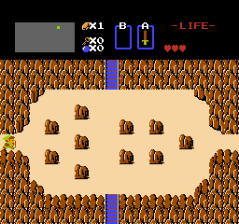
Screen Scrolling

Slide 27
Tweening
Short for “in-betweening”
  Animating a value from A to B over time
Comes from traditional animation
  Artists drew keyframes, assistants filled in the frames in between
Instead of snapping a position instantly, you move it a little each frame until it arrives
Used everywhere in games
  UI animations, camera movement, character transitions, screen wipes
The two things you always need to define:
  What is moving
  How fast / by what curve (Easings.net)

Slide 28
Linear Interpolation
The simplest tween curve - constant speed from A to B
lerp(a, b, t) = a + (b - a) * t where t goes from 0 to 1
  t = 0 → result is a
  t = 0.5 → result is exactly halfway
  t = 1 → result is b
"Linear" means equal steps
  The value moves the same amount every frame
Works on anything numeric
  floats, positions, colours, even angles
Non-linear curves (ease-in, ease-out) feel more natural but lerp is a good starting point

Slide 29
Screen Scrolling
When the player walks through a door, two things tween simultaneously
  The camera - from (0, 0) to _shiftTarget (one screen width/height away)
  The player - from the exit doorway to the matching entry point in the new room
The new room is placed at _shiftTarget and never moves
  The camera travelling toward it is what creates the scroll effect
All objects render through the same camera.Transform * screenScaleMatrix
  The whole scene shifts together
When shift is done new room becomes current room
  Camera & Player position is then reset
  Gameplay resumes (Room.Update is now called again)
// Dungeon.cs:147-155
_shiftProgress = Math.Min(1f, _shiftProgress + dt / GameSettings.RoomShiftDuration);
_camera.Position = Vector2.Lerp(Vector2.Zero, _shiftTarget, _shiftProgress);
_player.Position = Vector2.Lerp(_shiftPlayerStart, _shiftPlayerEnd, _shiftProgress);
Notes:
the lerp on the camera and the lerp on the player are independent but run in parallel, which is what makes the player look like they're walking through the doorway rather than floating across a black screen.
During the scroll, Room.Update is not called — enemies and gameplay are frozen until the transition finishes

Slide 30

Stenciling
Stencil buffer
Notes:
Stencil buffer

Slide 31
Data Driven Design
Content lives in config files, behaviour lives in C#
  This project uses XML — alternatives: JSON, YAML, TOML, Lua
Definition classes parse the files once at startup into dictionaries
  The rest of the code never touches XML
Adding a new enemy type = one <Enemy> block in XML + a spritesheet row
  No C# changes, no recompile
GameObject has no if (type == "switch") anywhere
  the XML defines valid states, the C# just looks up the current state name at draw time
<Enemy type="skeleton" width="16" height="16" walkSpeed="20" health="1">
<Animation name="walk-down" frames="9,10,11,10" interval="0.2" />
<Animation name="idle-down" frames="10" interval="0.2" />
</Enemy>
Tradeoff: typos in XML become runtime errors, not compile errors — the compiler can't catch type="skelton"
Notes:
point out that a designer can read and edit XML without knowing C#

Slide 32
Extending Zelda
Start from Zelda7, the finished game
Make some enemies drop hearts randomly, which heal the player for 2 damage
  I.e. one whole heart
Allow the player to lift pots
  Using the animations included in the sprite sheets here
Pots should stick to the player while they are carrying them
  The pot needs to track player position
Allow the player to throw pots and damage enemies
  If it hits a wall, an enemy, or travels farther than four tiles, destroy it.

Slide 33
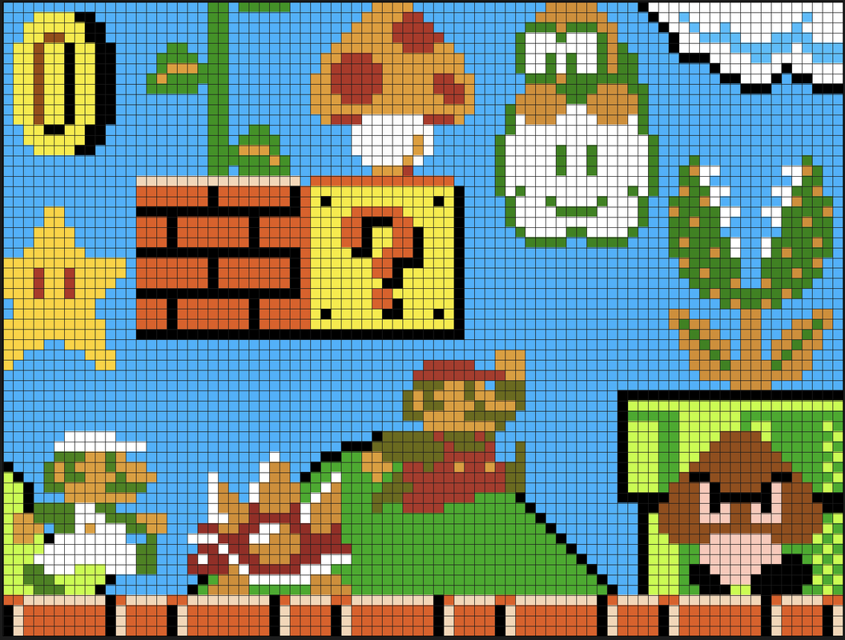
Apply it to Your Project
What are the meaningful moments in your game?
  The things that happen that other systems might care about
Map out at least two of them
  What fires the event, and what should react?
Is there anywhere a class knows too much about another?
  Could an event fix that?
If you haven't started yet: design your event structure before you write the code.
  It will shape how your classes relate to each other.

